Slide 1

Fighting Environmental Crimes
Aneesa, Iris, Rafael, Xiaoheng

Slide 2
—Leo Tolstory
“One of the first conditions of happiness is that the link between man and nature shall not be broken.”

Slide 3
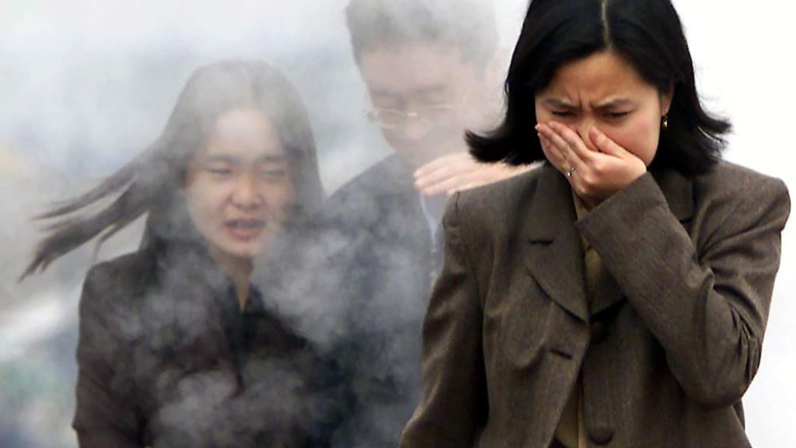
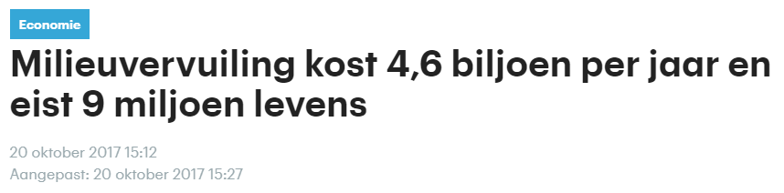
—Leo Tolstory
How many deaths due to environmental pollution every year?
“One of the first conditions of happiness is that the link between man and nature shall not be broken.”
Notes:
1 in 6 deaths

Slide 4
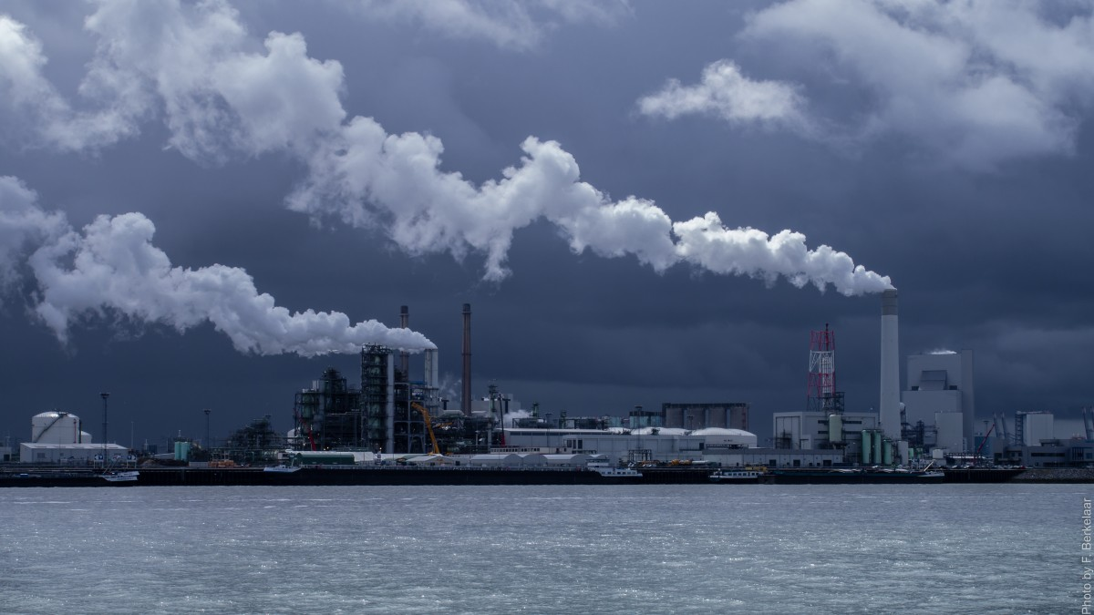
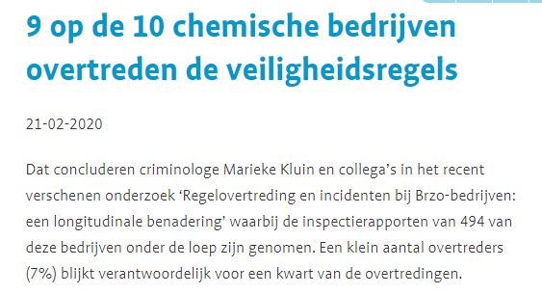
—Leo Tolstory
“One of the first conditions of happiness is that the link between man and nature shall not be broken.”
How many Dutch chemical companies violate safety regulations?
Notes:
9 in 10 chemical companies violate safety regulations, based on research university Leiden and Amsterdam

Slide 5
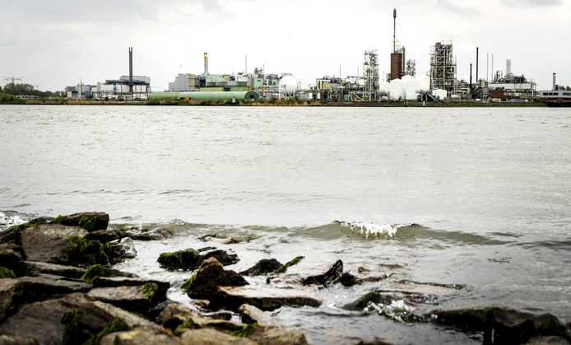
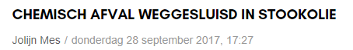
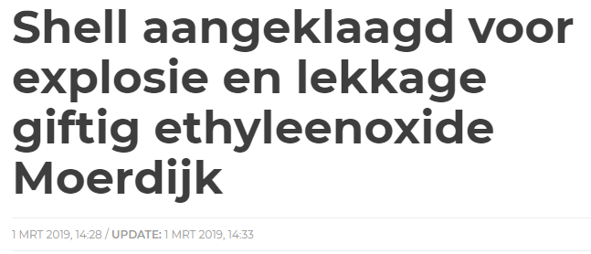
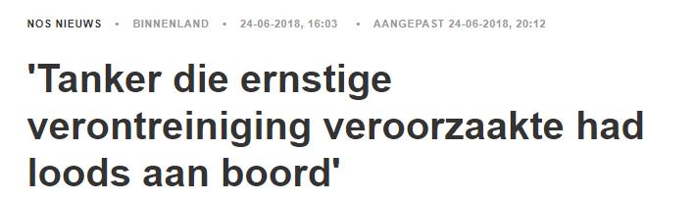
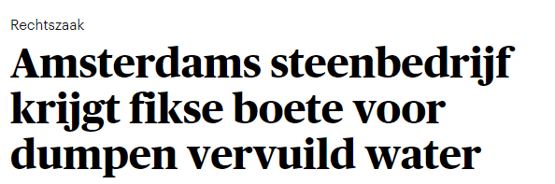
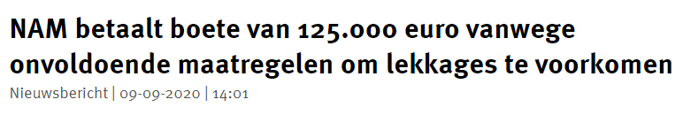
What does this mean for the environment?
Notes:
These are news items showing criminal activities of companies:
1Shell did not follow the safety good enough → explosion, also leaking cancer causing compound in air in November –January, due to not following safety instructions
2 Odfjell leaking oil after accident
3. Company Amsterdam dumping polluted water in harbor
4. Nam leaking in canals delft, not sufficient safety regulations
5. Chemical waste mixed in fuel oil

Slide 6
Let’s Unmask Environmental Crimes Together!

Slide 7

Who are they?

Slide 8



We don’t know what can we do about the suspicious activities around us…
Call the police
Social Media
Put an online complaint

Slide 9
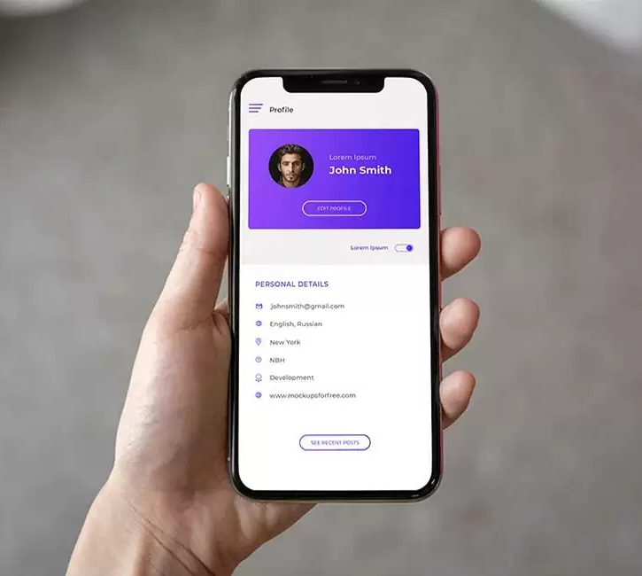

Milieuegy is different!

Slide 10
Data Flow
The Machine Learning algorithm decides if the new measurement is an anomaly
The user reports back to the app and corresponding authorities
Data is retrieved from the sensors
A notification is pushed to the user
Notes:
The diagram on this slide shows a simplified version of the Data Flow. First, measured data is retrieved from sensors. This data could be related to water quality or air pollution. Then, the Machine Learning algorithm decides if the new measurement is an anomaly. In case of an anomaly being detected near an app user, a notification is pushed to them. Finally, the user can take action and report back the app and the corresponding authorities and can complain about an environmental crime that the algorithm suspects. Thus, being able to unmask hidden environmental crimes.

Slide 11
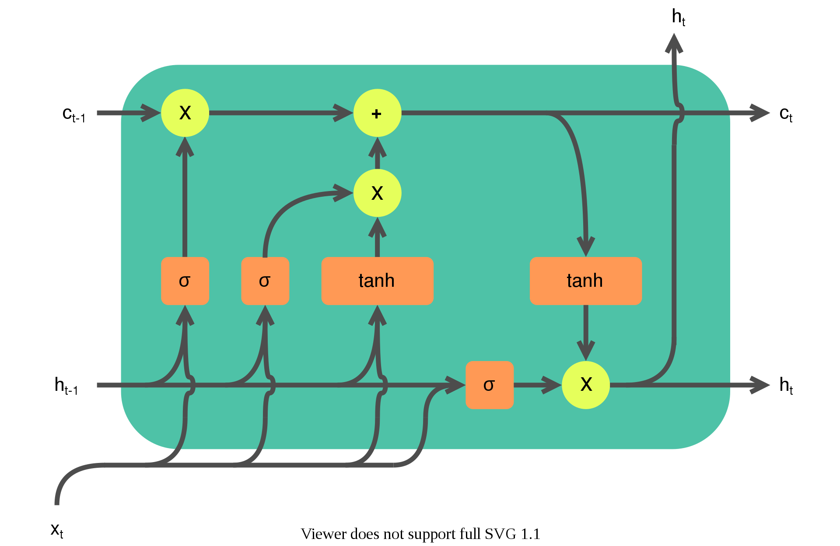
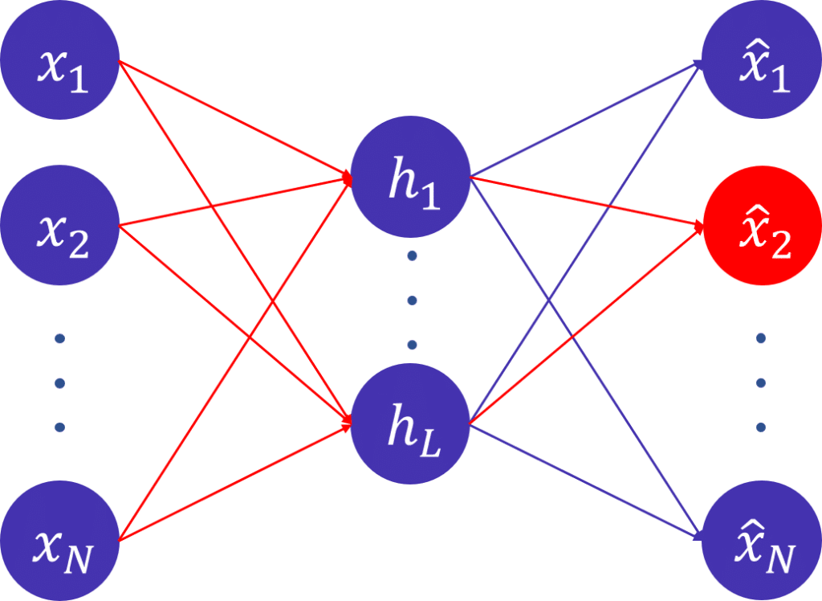
Algorithm
Time Series Anomaly Detection with LSTM Autoencoder
https://en.wikipedia.org/wiki/Long_short-term_memory
https://www.incubegroup.com/blog/autoencoder-anomaly-detection/
Notes:
The algorithm used for time series anomaly detection is an LSTM Autoencoder. A Long-Short Term Memory (LSTM) is an artificial Recurrent Neural Network (RNN) with feedback connections used in sequential data. An Autoencoder is a neural network designed to reproduced its input at the output layer, and has a bottleneck in the hidden layers, which forces the NN to learn the most important combinations of features of the data. An LSTM Autoencoder can be used for anomaly detection.

Slide 12
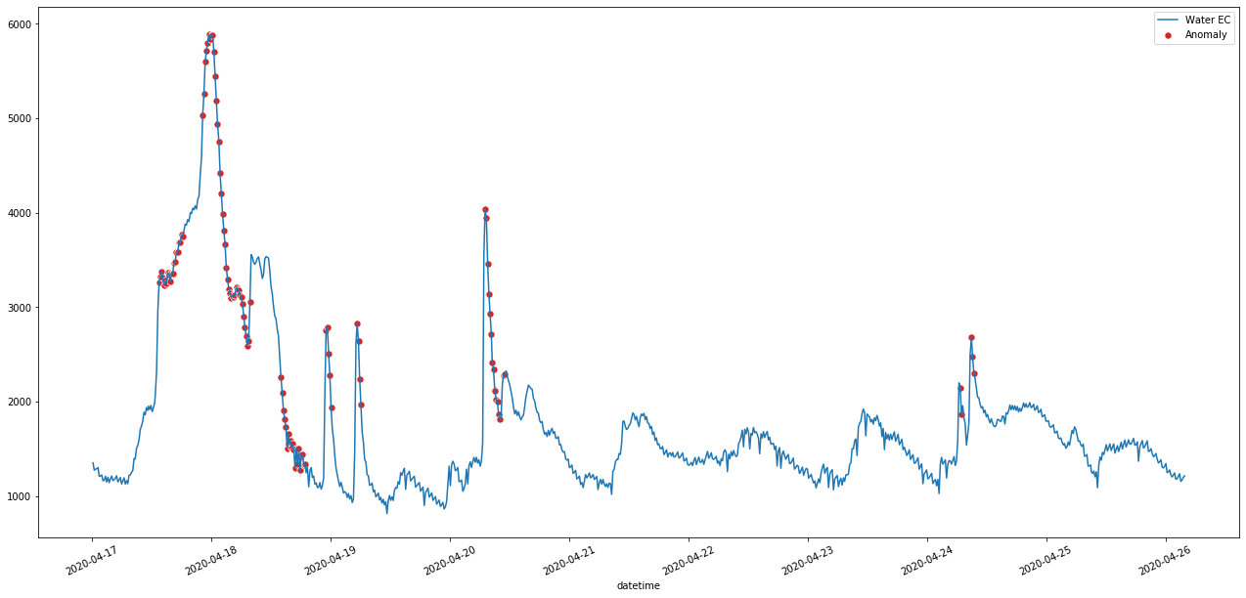
Algorithm
Time Series Anomaly Detection with LSTM Autoencoders - Water Electroconductivity
Notes:
And the output of the algorithm looks like this for Water Electroconductivity near The Hague. You can see the anomalies as red points in this plot.

Slide 13
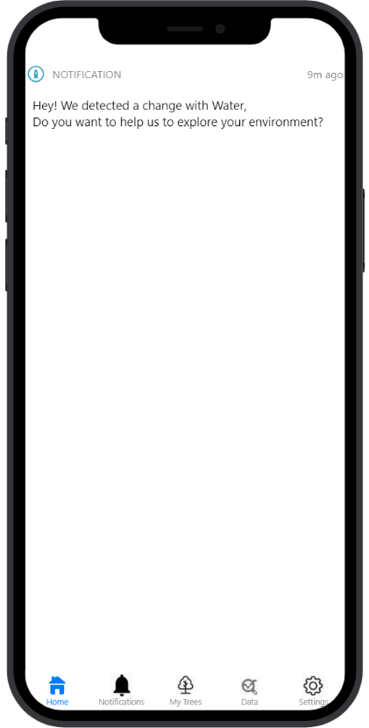



Our Solution

Slide 14
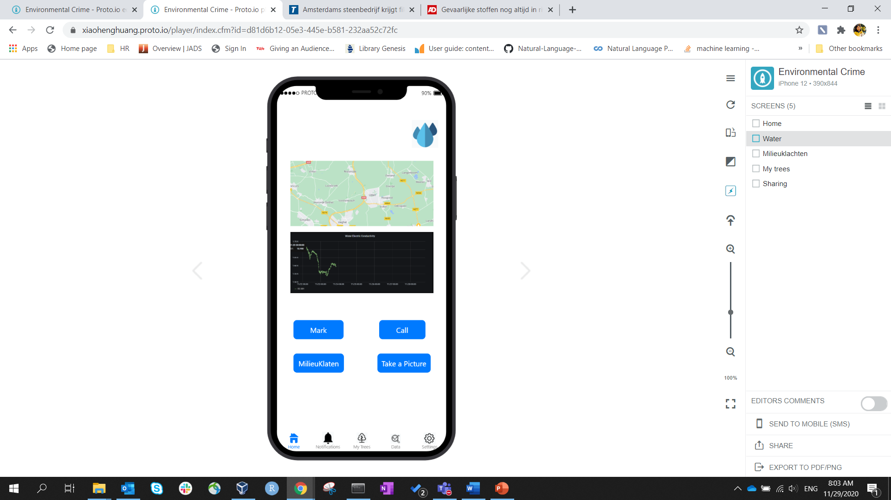
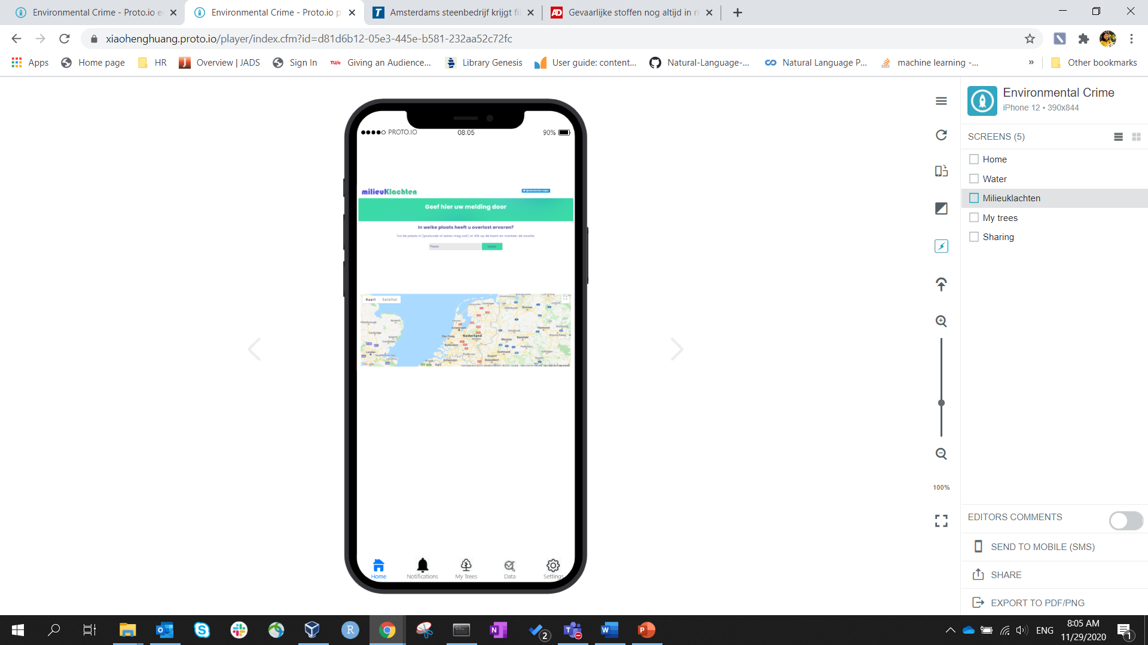
Our Solution

Slide 15
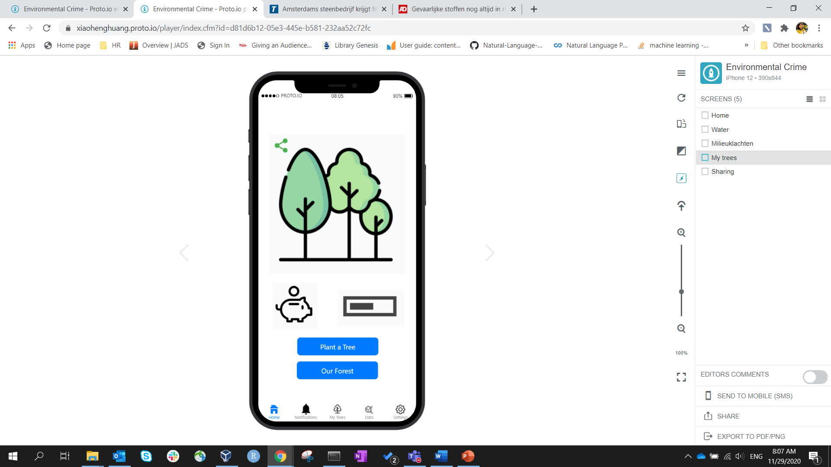

Our Solution

Slide 16


Your contribution matters!

